Slide 1
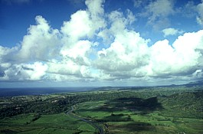
Atmospheric Movement and Local Weather
Notes:
http://www.srh.noaa.gov/crp/?n=education-heattransfer

Slide 2
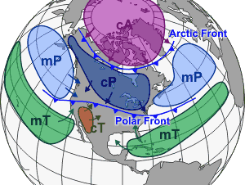
Air Masses
Notes:
http://www.srh.noaa.gov/crp/?n=education-airmasses

Slide 3
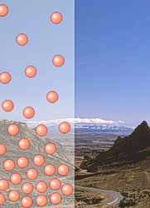
Air Pressure
Notes:
http://www.srh.noaa.gov/crp/?n=education-basicproperties

Slide 4
MoreDirect Sun Hot
90 º N
60 º N
30 º N
0 º Equator
30 º S
60 º S
90 º S

Slide 5

Convection
Currents
Notes:
http://pap.wikipedia.org/wiki/File:Convection.gif

Slide 6
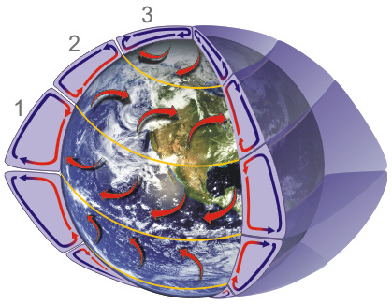
Global Convection Cells
Notes:
http://www.srh.noaa.gov/jetstream/global/circ.htm

Slide 7
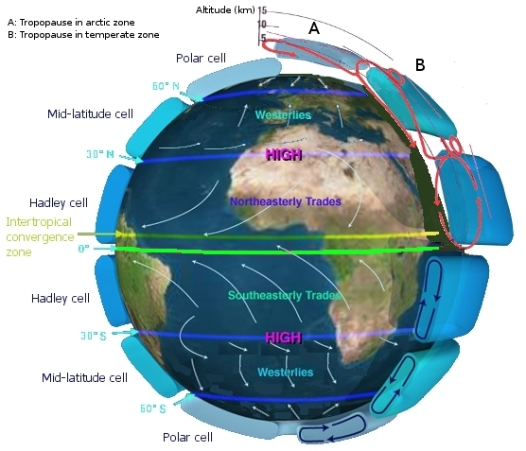
Global Wind
Patterns
Notes:
http://en.wikipedia.org/wiki/File:Earth_Global_Circulation.jpg

Slide 8
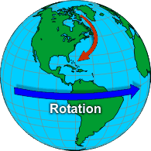
The Coriolis
Effect
Notes:
http://www.srh.noaa.gov/srh/jetstream/synoptic/wind.htm

Slide 9
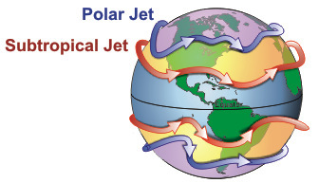
Jet Stream
Notes:
http://en.wikipedia.org/wiki/Jet_stream

Slide 10
Jet Stream
Forms high in the upper troposphere between two air masses of different temperatures
Higher temperature difference = faster speed
Due to the Coriolis Effect, it flows around air masses.
Polar Jet:
  It dips southward when frigid polar air masses move south.
  It tends to stay north in the summer months.

Slide 11
Jet Stream
Animation
Notes:
You may wish to insert an approved jet stream animation on this slide. Otherwise, consider hiding the slide.

Slide 12
Reflection Question
Why does the Earth have wind?

Slide 13
Variables Affecting Local Weather

Slide 14
Fronts
When convection and winds cause air masses to move, they bump into one another.
The area where two air masses meet is called a front.
Most severe weather occurs near frontal boundaries.

Slide 15
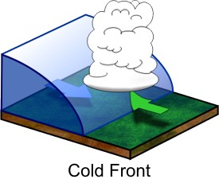
Cold Front
- Cold air meets warm air
- Fast moving and stormy
- Severe weather is likely.
Notes:
http://www.srh.noaa.gov/crp/?n=education-airmasses

Slide 16

Cold Front Symbol
Notes:
http://commons.wikimedia.org/w/index.php?title=File:Cold_front_symbol.svg&page=1

Slide 17
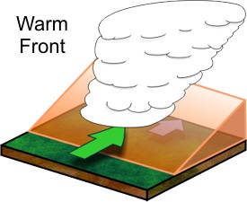
Warm Front
- Warm air meets cold air
- Slow moving with less severe weather
Notes:
http://www.srh.noaa.gov/crp/?n=education-airmasses

Slide 18

Warm Front Symbol
Notes:
http://commons.wikimedia.org/w/index.php?title=File:Warm_front_symbol.svg&page=1

Slide 19
Stationary Front
Warm and cool air masses that are not strong enough to move one another
Sits still for a long period of time

Slide 20

Stationary Front
Symbol
Notes:
http://commons.wikimedia.org/w/index.php?title=File:Stationary_front_symbol.svg&page=1

Slide 21
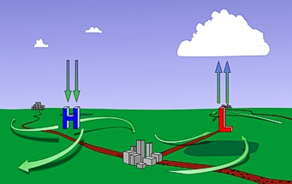
Friction
Notes:
http://www.srh.noaa.gov/crp/?n=education-wind

Slide 22
Frontal Boundary Animation
Notes:
You may wish to insert an approved frontal boundary animation on this slide. Otherwise, consider hiding the slide.

Slide 23
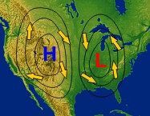
High and Low Pressure Circulation
Notes:
http://www.srh.noaa.gov/srh/jetstream/synoptic/wind.htm

Slide 24
Air Pressure and Wind
Air pressure is measured with a barometer in millibars.
Millibars are represented by connected lines of equal pressure. This is a lot like the topographic map lines.
The closer together the lines are, the faster the wind speed.
The farther apart the lines are, the slower the wind speed.

Slide 25
The Earth’s Insulator
The Sun heats the water and land every day.
Land heats up rapidly, but cools off rapidly.
  Desert
Water heats up slowly, but cools off slowly.
  Swimming at night
The heat retained by the oceans is what keeps our planet insulated.

Slide 26
Land and Sea Breezes
The heating and cooling of water and land produces land breezes and sea breezes.
High pressure moves toward low pressure, pushing the warm air upward.
As warm air rises, cooler air moves in and replaces it.

Slide 27
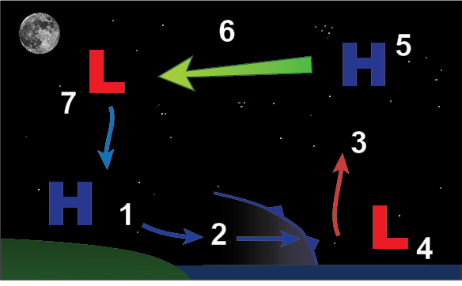
Land Breeze
Notes:
http://www.srh.noaa.gov/jetstream/ocean/seabreezes.htm

Slide 28
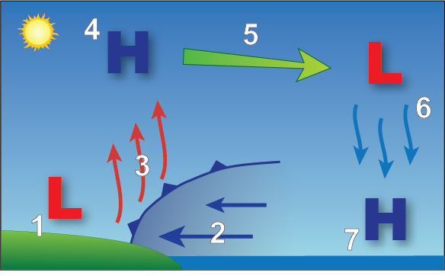
Sea Breeze
Notes:
http://www.srh.noaa.gov/jetstream/ocean/seabreezes.htm

Slide 29
Sea Breeze and Land Breeze Animation
Notes:
You may wish to insert an approved animation of land and sea breezes on this slide. Otherwise, consider hiding the slide.

Slide 30
Reflection Question
How do global patterns of atmospheric movement affect local weather?

